Slide 1

BUREAU OF STANDARDS JAMAICA
Making Standards Work For You…

Slide 2
MISSION STATEMENT
To promote the international competitiveness of Jamaican producers ,facilitate the trade and protect consumers by providing regulatory service through a qualified and committed, motivated team.

Slide 3
BACKGROUND
The Bureau was established in July 1969 by the Standards Act(1969). The regulation Empower the organization to promote and encourage the maintenance of standardization in relation of commodities, processes and practices
The core activities are:
  Facilitate standards development activities
  Registration of establishments
  Monitoring for compliance
  Calibration and testing services
  Certifying management systems and products
  Promoting research ,Training and education in standardization

Slide 4
Other Regulations
The Processed Foods Act (1959) currently under review
Weights And Measure Act (1976)

Slide 5



REGULATORTY FUNCTIONS
Food Safety Activities (FSA)
Bureau of Standards Jamaica administer the:
  Processed Food Act and Regulations 1959
  Standard Act JS 36
      Jamaica Standard Specification for
      Processed Food (General) – JS 36, 1991

Slide 6
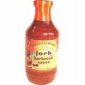



REGULATORTY FUNCTIONS
Under the FSA, the functions are as follows:
Registration – register food processing plants – for verification of compliance with specific Regulations and standards.
Inspection – Inspect sanitary conditions, hygienic practices and processing techniques in food processing establishments.
Product Sampling – Sample processed food for subsequent analyses/testing (e.g. chemical/microbiological analyses; organoleptic evaluation; package integrity checks).
Certification – Evaluate results of analyses/tests to ensure compliance with standards. Issue Certificate of Approval or Export to facilitate sale locally or in the overseas market.

Slide 7
REGULATORTY FUNCTIONS
Development of Standards – assist in the development of food standards (all of which are mandatory).
Advisory – Advise processors and potential processors on legal requirements of local and international markets.
Technical Assistance – Provide resource person/persons for in-plant training attachment for industry personnel.
The Food Inspectorate Training and Development – Food inspection is a high specialized activity, requiring a combination of formal training and extensive practical experience. Inspection personnel are University graduates, some with post-graduate training in Food Science, or graduates of a technical institution, with experience in the food industry.

Slide 8
LEGAL REQUIREMENT FOR EXPORT
) No person shall export or sell or attempt to export or sell (a) any prescribed food, unless a certificate has been issued in respect of such food in accordance with paragraph (a) of subsection (1); or
(b) any prescribed food that is packed in containers that are tagged in accordance with paragraph (b) of the said subsection
An inspector shall not certify as being fit for export or for sale any articles in an establishment where the sanitary conditions do not comply with the provisions of this Act
prescribed” means prescribed by the Act in which the word occurs or by any regulations made there under, and, in relation to any regulations, where no other authority is empowered in that behalf in the Act, means prescribed by the Governor-General in Council;

Slide 9
LIST OF PRESCRIBED FOODS
(UNDER THE PROCESSED FOOD ACT 1959)
Grapefruit Segments (whole and broken)
Grapefruit Juice (straight and concentrate)
Canned Mango (slices)
Mango with Rum
Marmalade (Orange)
Canned Orange Juice (straight and concentrate)
Canned Pineapple (slices and chunks)
Pineapple Juice
Tomato in skin
Canned Tomatoes
Tomato Juice
Tomato Juice Cocktail
Tomato Ketchup
Canned Yams
Canned Ackees
Jellies
Jams
Guava Cups
Guava Halves
Fruit Nectars
Sauces
Hot Sauce
Hot Pepper Sauce
Table Sauce
Soya Sauce
etc.
Pickled Cucumbers
Susumber
Canned Soups

Slide 10
LIST OF PRESCRIBED FOODS
(UNDER THE PROCESSED FOOD ACT 1959)
Guava Cups
Guava Halves
Fruit Nectars
Sauces
Hot Sauce
Hot Pepper Sauce
Table Sauce
Soya Sauce
etc.
Pickled Cucumbers
Susumber
Canned Soups
Vinegar
Syrups
Processed Meats -
Viennas
- Hams
- Bacon
- Frankfurters
- Bologna
- Salami
Curried Mutton (frozen)
Macaroni & Mince
Mackerel & Bananas
Sweet Potato Mix
Rice & Peas
Fried Plantain
Oxtail in Wine
Stewed Beef
Ackee & Saltfish
Stew Peas
Chicken (Maryland Style)
Beef Balls

Slide 11
Current Cost for Various Certificates

Slide 12
USA-FSMA PROPOSED RULES
Under the proposed rule for Foreign Supplier Verification Programs (FSVP), importers would need to verify that their suppliers are meeting the same U.S. safety standards required of domestic producers. Requirements for verification activities would be primarily based on the type of food, nature of the hazard identified and on who—such as the foreign supplier, the importer, or the importer’s customer—is best able to control the hazard.
Under the proposed rule for Accreditation of Third Party Auditors, FDA would recognize accreditation bodies based on certain criteria such as competency and impartiality. The accreditation bodies, which could be foreign government agencies or private companies, would in turn accredit third party auditors to audit and issue certifications for foreign food facilities.

Slide 13
Legal Metrology
The Division is empowered under the Weights & Measure Act 1976 and is responsible to ensure “Equity in Trade.” This principle protects the buyer’s interest, and safeguards the integrity of the seller. This role is achieved by:
  establishing practical guidelines for weighing and measuring equipment
  ensuring compliance through test and inspections
  responding promptly to consumer complaints

Slide 14




REGULATORY FUNCTIONS
Legal Metrology (cont’d)
The Inspectors:
  inspect and test equipment for accuracy
  verifies the contents of prepackaged goods and give advise on the correct use of equipment
  test equipment
A variety of equipment is checked by the inspectors;
  scale,
  measures,
  dispensers at petrol stations.
  weigh-bridges

Slide 15



REGULATORTY FUNCTIONS
Legal Metrology (cont’d)
Volumetric measurement tests are also conducted to accurately determine the volume of containers. These range from single –serve retail containers through to industrial haulage and storage tanks. Counterpoise weights and test weights are also tested and adjusted when necessary.

Slide 16
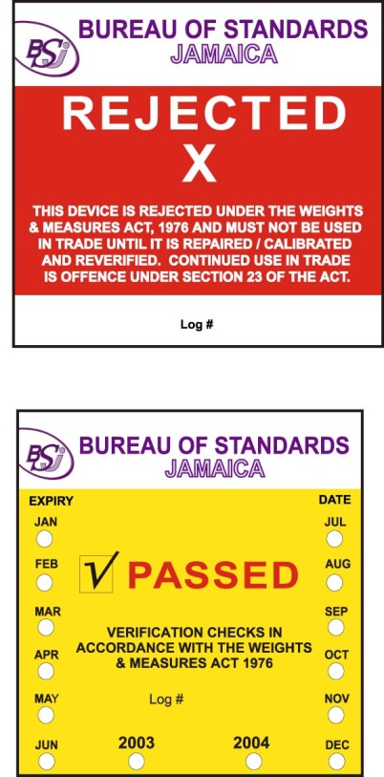
REGULATORY FUNCTIONS
Legal Metrology (cont’d)
Equipment which is tested and found to be accurate is marked with a “Passed” sticker.
On the other hand, equipment deemed to be inaccurate is marked with a “Rejected” sticker. Owners of inaccurate equipment are required to have them corrected, re-tested and passed, before putting them back into use.

Slide 17

REGULATORTY FUNCTIONS
Standards Compliance
Provides level playing field
Designed to ensure that all products sold in Jamaica – whether made in Jamaica or abroad – conform to acceptable standards pertaining to health, safety, performance and labeling
Jamaica made goods have been required to meet product and labeling standards since 1959, when the Processed Food Act was promulgated.

Slide 18
REGULATORTY FUNCTIONS
Standards Compliance (cont’d)
Today there are over 100 compulsory national Standards. These standards cover a range of commodities.
  The technical information contained in these standards can be used to assist manufacturers produce goods of acceptable quality.
  They can be used to guide Importers and Traders in making sound purchases or to set purchasing specifications for goods and raw materials.

Slide 19
REGULATORTY FUNCTIONS
Standards Compliance (cont’d)
Prevents
Inconsistent quality,
Waste of materials, labor, and foreign exchange,
Hazards to producers
and users,
Compensation and refunds to customers arising from complaints about product failure or from misleading information on the label.

Slide 20
REGULATORTY FUNCTIONS
Standards Compliance (cont’d)
Against the background of a deregulated economy resulting in an influx of commodities of poor quality and goods banned elsewhere being dumped on the Jamaican market.

Slide 21
REGULATORTY FUNCTIONS
Standards Compliance (cont’d)
Import Monitoring Programme:
This was launched in November 1993.
Under this programme, Officers of the Bureau inspect goods at ports of entry, warehouses, and at retail outlets. Samples may be taken for testing to determine compliance with mandatory regulations.
Goods found to be in breach of compulsory standards have been subject to re-export, detention at port of entry or withdrawal from the marketplace for correction or destruction.

Slide 22

Thank you for your attention

